Slide 1
Multi-way search trees

Slide 2
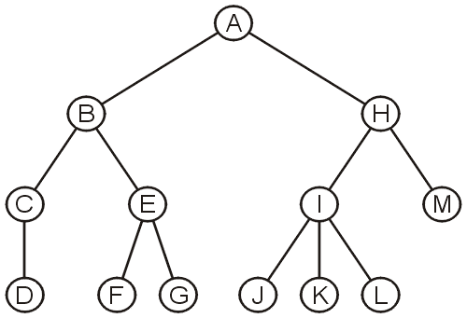
In-order traversals on general trees
We have noted that in-order traversals only make sense for binary search trees and not N-ary trees in general

Slide 3
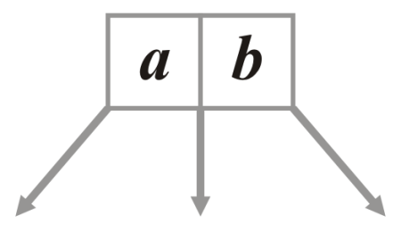
3-Way Trees
Suppose we had a node storing two values and with three sub-trees:

Slide 4
3-Way Trees
This could be implemented as follows:
class Three_way_node<T> {
Three_way_node left_tree;
T first_element;
Three_way_node middle_tree;
T second_element;
Three_way_node right_tree;
// ...
};
left_element
right_element
left_tree
middle_tree
right_tree

Slide 5
3-Way Trees
In order to define a search tree, we will require that:
The first element is less than the second element
All sub-trees are 3-way trees
The left sub-tree contains items less than the 1st element
The middle sub-tree contains items between the two elements
The right sub-tree contains items greater than the 2nd element
left_element
right_element
left_tree
middle_tree
right_tree

Slide 6
3-Way Trees
If a node has only one element, all trees are assumed to be empty
If a second object is inserted, it will be inserted into this node
class Three_way_node<T> {
Three_way_node left_tree;
T first_element;
Three_way_node middle_tree;
T second_element;
Three_way_node right_tree;
int num_elements; # 1 or 2
bool full()
return num_elements == 2;
}

Slide 7
Insertion into 3-Way Trees
6.4.2.2
Consider inserting values into an empty 3-way tree:
Starting with 68, it would be inserted into the root

Slide 8

Insertion into 3-Way Trees
6.4.2.2
If 27 was inserted next, it would be fit into the root node

Slide 9

Insertion into 3-Way Trees
6.4.2.2
If 27 was inserted next, it would be fit into the root node

Slide 10
Insertion into 3-Way Trees
6.4.2.2
Any new insertion would create an appropriate sub-tree
Inserting 91, we note that 91 > 68, so a right sub-tree is constructed

Slide 11
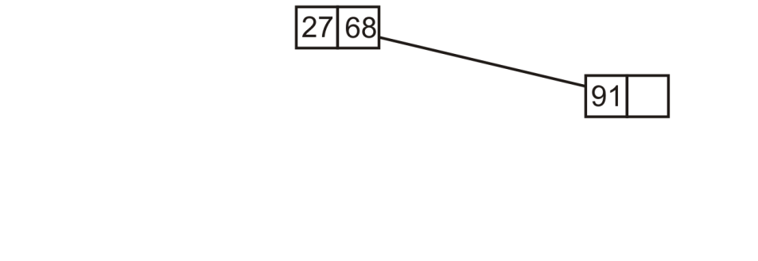
Insertion into 3-Way Trees
6.4.2.2
Any new insertion would create an appropriate sub-tree
Inserting 91, we note that 91 > 68, so a right sub-tree is constructed

Slide 12
Insertion into 3-Way Trees
6.4.2.2
If we insert 38, we note that 28 < 38 < 68 and thus build a new sub-tree in the middle

Slide 13
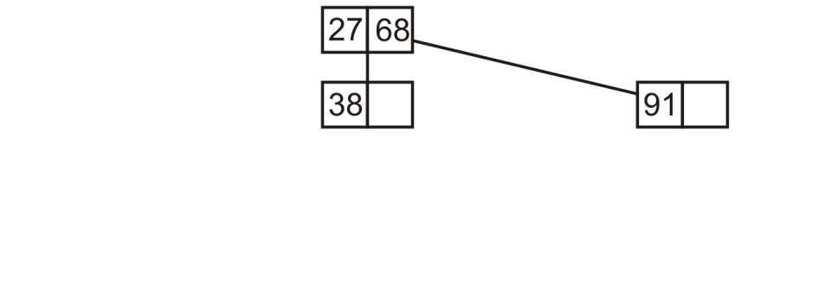
Insertion into 3-Way Trees
6.4.2.2
If we insert 38, we note that 28 < 38 < 68 and thus build a new sub-tree in the middle

Slide 14
Insertion into 3-Way Trees
6.4.2.2
At this point, if we insert 82, we note 82 > 68 and the right sub-tree is not yet full

Slide 15
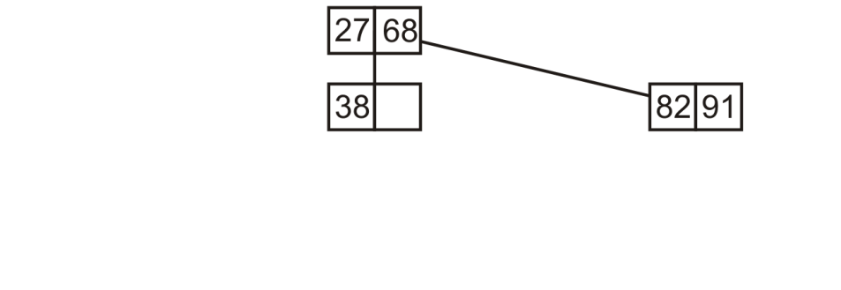
Insertion into 3-Way Trees
6.4.2.2
At this point, if we insert 82, we note 82 > 68 and the right sub-tree is not yet full

Slide 16
Insertion into 3-Way Trees
6.4.2.2
If we insert 14, we note 14 < 27, so we create a new node

Slide 17
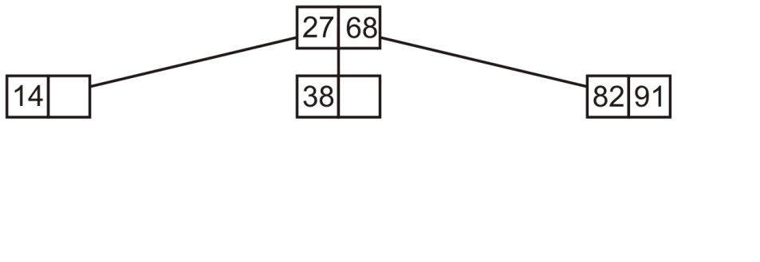
Insertion into 3-Way Trees
6.4.2.2
If we insert 14, we note 14 < 27, so we create a new node

Slide 18
Insertion into 3-Way Trees
6.4.2.2
Next, inserting 62, 27 < 62 < 28 so we insert it into the middle sub-tree which also is not full

Slide 19
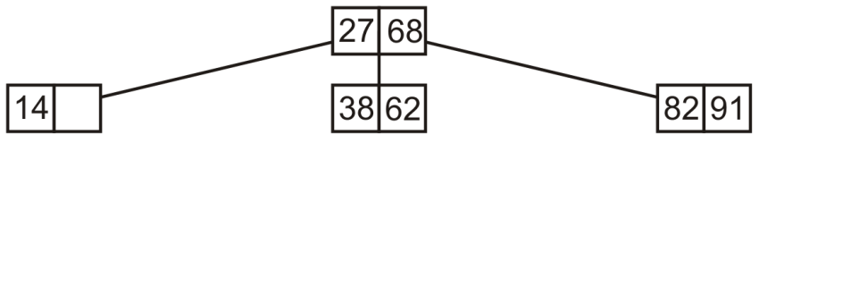
Insertion into 3-Way Trees
6.4.2.2
Next, inserting 62, 27 < 62 < 28 so we insert it into the middle sub-tree which also is not full

Slide 20
Insertion into 3-Way Trees
6.4.2.2
If we insert 45,
First, 27 < 45 < 68 and then 38 < 45 < 62

Slide 21
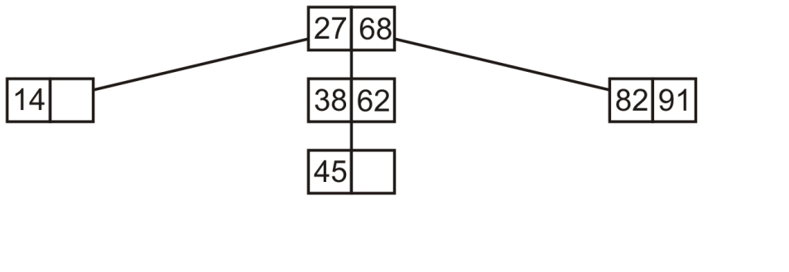
Insertion into 3-Way Trees
6.4.2.2
If we insert 45,
First, 27 < 45 < 68 and then 38 < 45 < 62

Slide 22
Insertion into 3-Way Trees
6.4.2.2
If we insert 76, we note 68 > 76 but then 76 < 82
Create a new left sub-tree of the 82-91 node

Slide 23
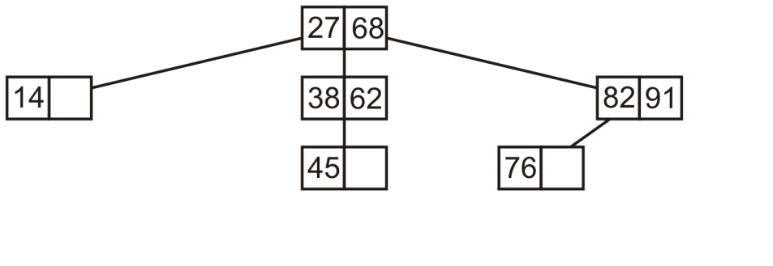
Insertion into 3-Way Trees
6.4.2.2
If we insert 76, we note 68 > 76 but then 76 < 82
Create a new left sub-tree of the 82-91 node

Slide 24
Insertion into 3-Way Trees
6.4.2.2
If we insert 4, 4 < 27 and the left sub-tree contains only a single element

Slide 25
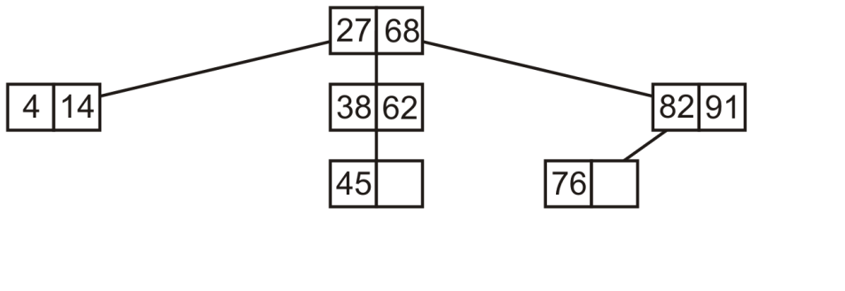
Insertion into 3-Way Trees
6.4.2.2
If we insert 4, 4 < 27 and the left sub-tree contains only a single element

Slide 26
Insertion into 3-Way Trees
6.4.2.2
If we insert 51, 27 < 51 < 68 and 38 < 51 < 62; therefore, we insert 51 into the node containing 45

Slide 27
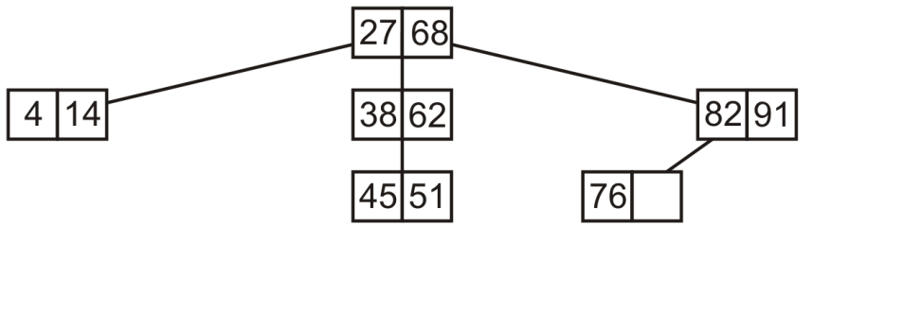
Insertion into 3-Way Trees
6.4.2.2
If we insert 51, 27 < 51 < 68 and 38 < 51 < 62; therefore, we insert 51 into the node containing 45

Slide 28
Insertion into 3-Way Trees
6.4.2.2
If we insert 8, 8 < 27 and then 4 < 8 < 14
Construct a new middle sub-tree of the 4-14 node

Slide 29
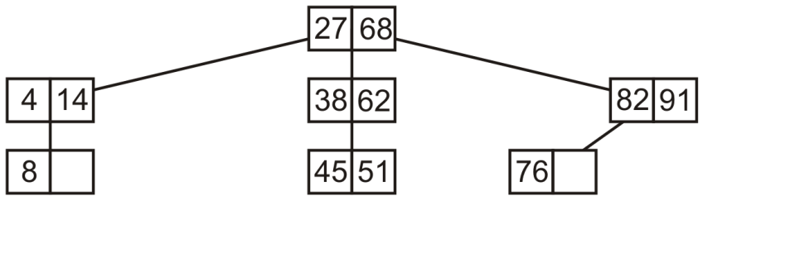
Insertion into 3-Way Trees
6.4.2.2
If we insert 8, 8 < 27 and then 4 < 8 < 14
Construct a new middle sub-tree of the 4-14 node

Slide 30
Insertion into 3-Way Trees
6.4.2.2
If we insert 98, 98 > 68 and 98 > 91
Construct a new right sub-tree of the 81-91 node

Slide 31
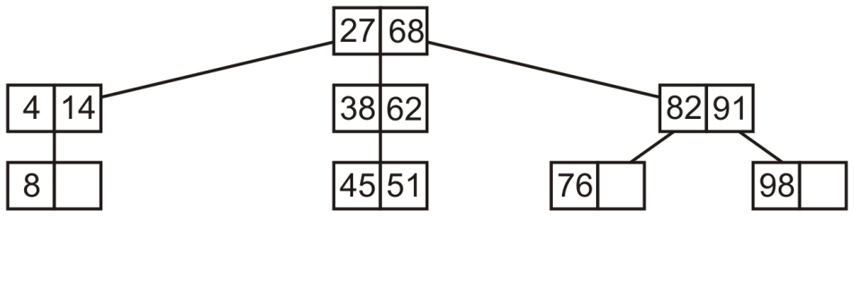
Insertion into 3-Way Trees
6.4.2.2
If we insert 98, 98 > 68 and 98 > 91
Construct a new right sub-tree of the 81-91 node

Slide 32
Insertion into 3-Way Trees
6.4.2.2
Finally, consider adding 57:
27 < 57 < 68, 38 < 57 < 62 and 57 > 51
Construct a new right sub-tree of the 45-51 node

Slide 33
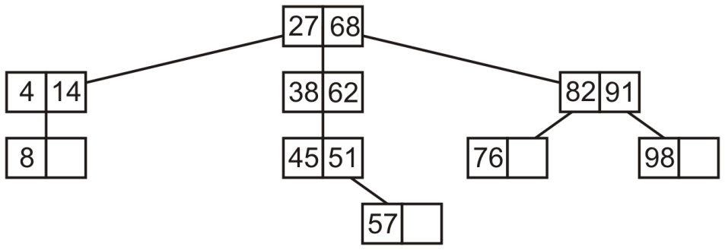
Insertion into 3-Way Trees
6.4.2.2
Finally, consider adding 57:
27 < 57 < 68, 38 < 57 < 62 and 57 > 51
Construct a new right sub-tree of the 45-51 node

Slide 34
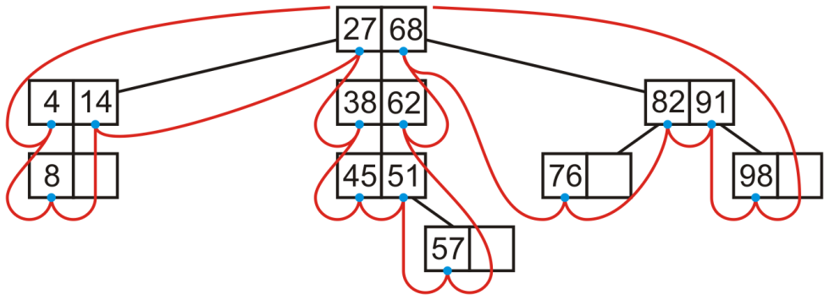
In-order Traversals
6.4.2.3
An in-order traversal can be performed on this tree:
4 8 14 27 38 45 51 57 62 68 76 82 91 98

Slide 35
In-order Traversals
6.4.2.1
Insertion also becomes much more interesting
inorder_traversal(TreeNode root)
if ( empty() )
return;
if ( !full() )
cout << root. first_element;
else
inorder_traversal(root.left_tree);
cout << root. first_element;
inorder_traversal(root.middle_tree);
cout << root. second_element;
inorder_traversal(root.right_tree);

Slide 36
Multiway tree implementation
6.4.3
Suppose we had a node storing N – 1 values and with N sub-trees
We will describe this as an N-way tree
class Multiway_node<Type>
int num_elements;
Type elements[N – 1];
Multiway_node [N];
bool full()
return ( num_elements == N - 1 );

Slide 37
Size
6.4.3.1
Question:
What is the maximum number of elements which may be stored in a multiway tree of height h?
We will consider 3-way trees and, if possible, generalize

Slide 38
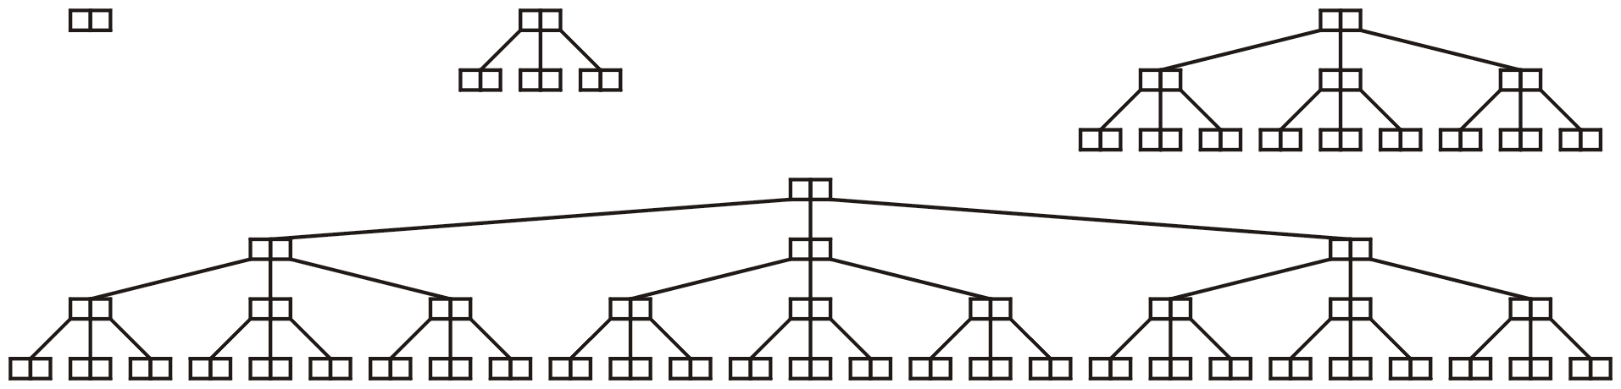
Size
6.4.3.1
Examining these perfect 3-way trees
we get the table:
h | Size | Formula
0 | 2 | 3¹ – 1
1 | 8 | 3² – 1
2 | 26 | 3³ – 1
3 | 80 | 3⁴ – 1

Slide 39
Size
6.4.3.1
Suggested form:
The maximum number of nodes in a perfect multiway tree of height h is N^{h + 1} – 1

Slide 40
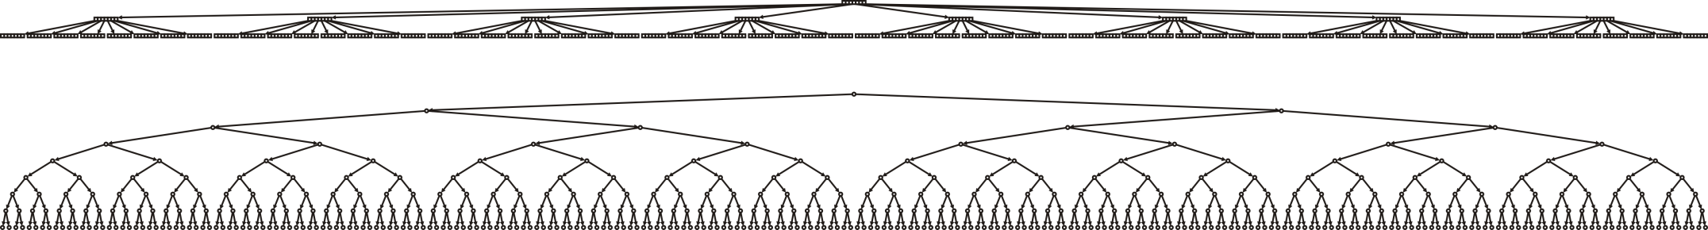
8-way trees versus binary trees
6.4.3.3
Compare:
A perfect 8-way tree with h = 2
511 elements in 73 nodes
A perfect binary tree with h = 8
511 elements in 511 nodes

Slide 41
8-way tree example
6.4.3.4
A sample 8-way search tree:
Note how a binary search is required to find the appropriate sub-tree
How do you determine if 43 is in this search tree?
Question: what order would these entries have been inserted?
How do we erase an element?

Slide 42
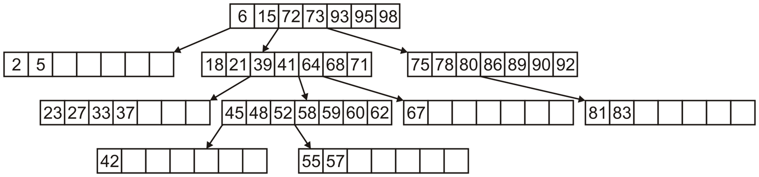

Slide 43
Multiway trees
6.4.3.4
Advantage:
Shorter paths from the root
Disadvantage:
More complex
Under what conditions is the additional complexity worth the effort?
When the cost from jumping nodes is exceptionally dominant

Slide 44
Summary
In this topic, we have looked at:
Multiway trees
Each node stores N – 1 sorted elements
N sub-trees interleave the elements
Perfect Multiway trees store N^{h +1} – 1 elements
We saw an implementation in Java
We considered in-order traversals of multiway trees
Has the potential to store more elements in shallower trees

